Slide 1


FRAUD DETECTION Presenter: Mostafa Maged Date: 8/11/2024

Slide 2

AGENDA
Project Idea
Project Pipeline
End Users + Features
Data Structure &Description
Programming Languages + Frameworks
Live Application
Deliverables
Project Team + Roles

Slide 3

PROJECT IDEA
Problem Description:
Fraud detection is critical for protecting financial institutions and customers from fraudulent activities. Traditional systems struggle with catching evolving patterns of fraud.
Proposed Solution:
The solution involves developing and training machine learning models that can efficiently detect fraudulent transactions using various features such as transaction amount, user demographics, and transaction patterns.
Unique Value Proposition:
Our approach utilizes multiple machine learning models (e.g., Logistic Regression, Random Forest, XGBoost) and selects the best-performing model based on recall metrics for fraud detection. This ensures an optimized system for identifying fraudulent activities while minimizing false positives.

Slide 4
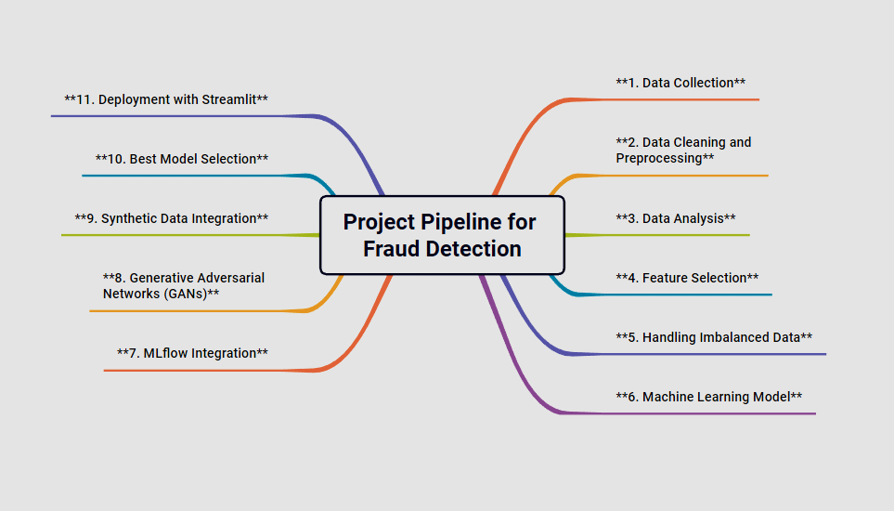

Slide 5
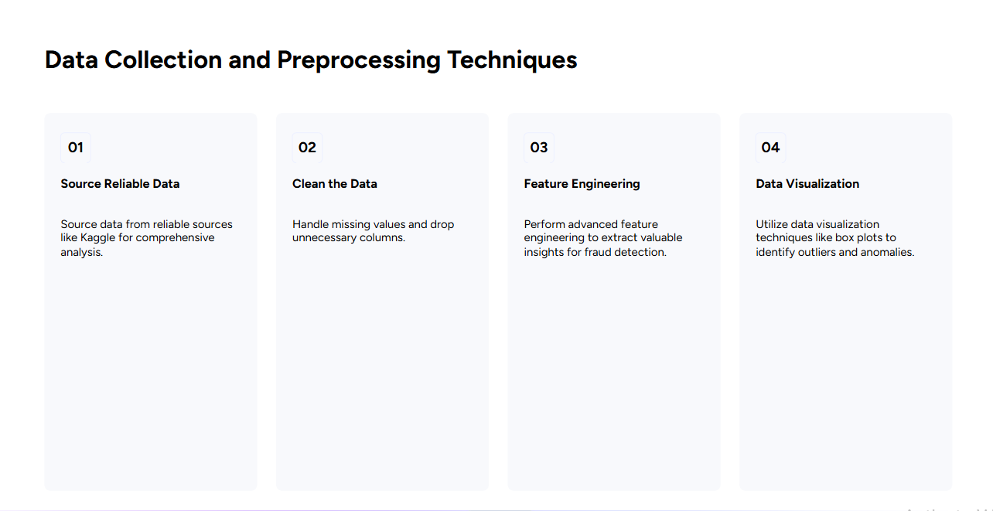

Slide 6

END USERS + FEATURES
Primary User Personas:
Financial Institutions
E-commerce Platforms
Individual Customers
Regulatory Agencies
Key Features:
Real-Time Fraud Detection
End Users: Financial Institutions, E-commerce Platforms
Solves: Immediate prevention of fraudulent transactions.

Slide 7
END USERS + FEATURES
Risk Scoring System
End Users: Financial Institutions, Individual Customers
Solves: Prioritizes high-risk transactions for faster action.
Automated Alerts
End Users: Individual Customers, E-commerce Platforms
Solves: Notifies users instantly of suspicious activity.
Analytics Dashboard
End Users: Regulatory Agencies, Financial Institutions
Solves: Provides insights into fraud trends for better monitoring and compliance.

Slide 8

DATA STRUCTURE
Database Architecture:
Architecture: CSV file (Relational)
Key Entities: Transactions, Customers, Merchants Data
Flow: Collected, stored, and accessed from CSV files for analysis

Slide 9
DATA STRUCTURE
Data Overview:
The dataset revolves around transaction data. Key entities can be described as:
Transactions: Each row represents a transaction made by a user.
Features: user demographics, transaction time, and amount.

Slide 10
DATA STRUCTURE
Relationships: Although CSV is flat and does not inherently support relationships, the structure assumes implicit relationships, such as:
User to Transaction: One user can perform many transactions.
Transaction to Time/Amount: Each transaction has a timestamp, and an amount spent.

Slide 11
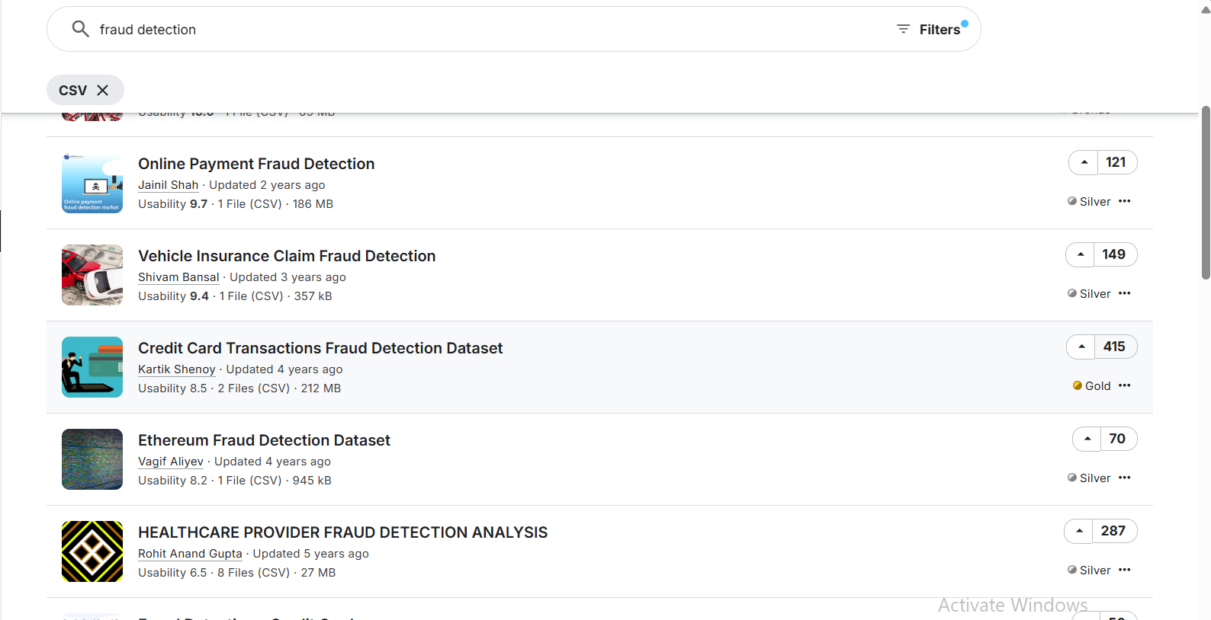
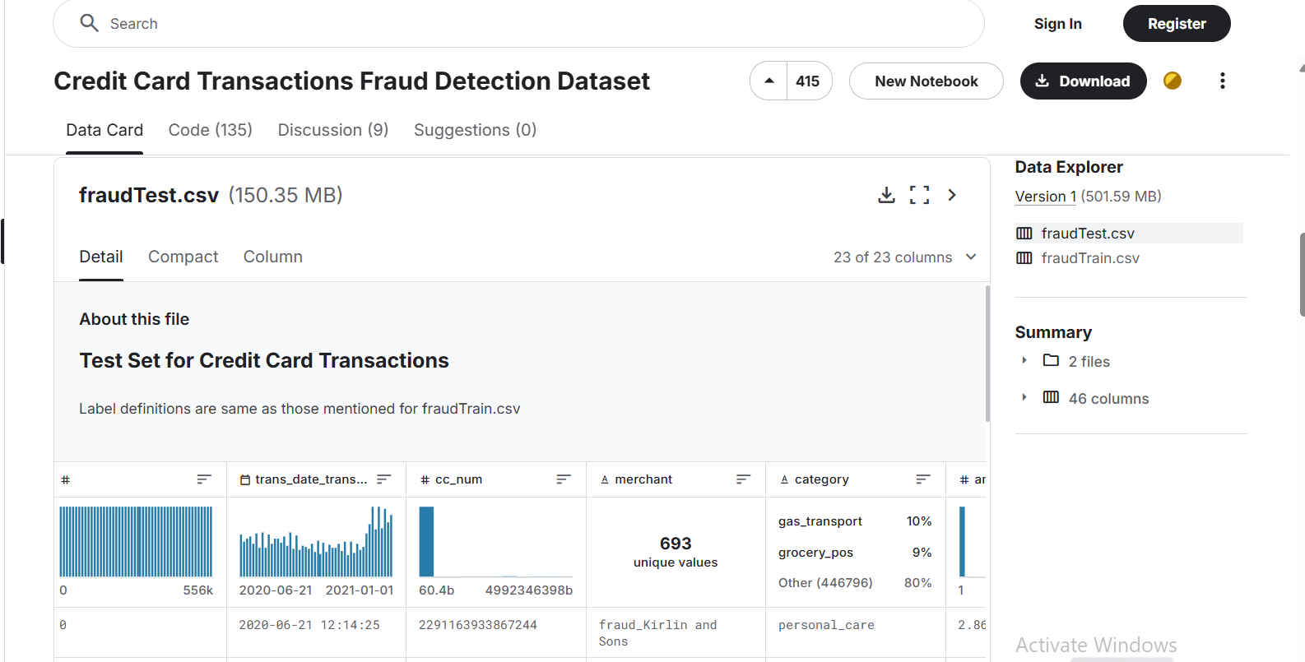
Source reliable data

Slide 12
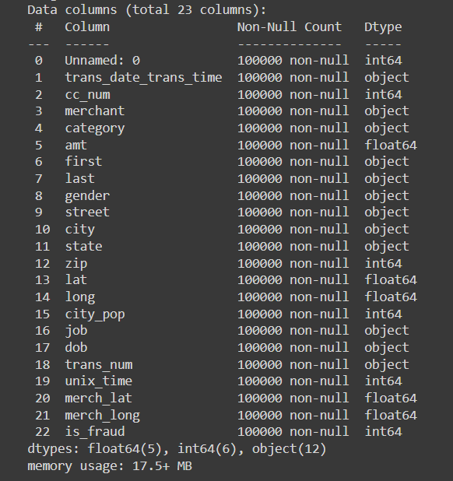
Data Cleaning

Slide 13
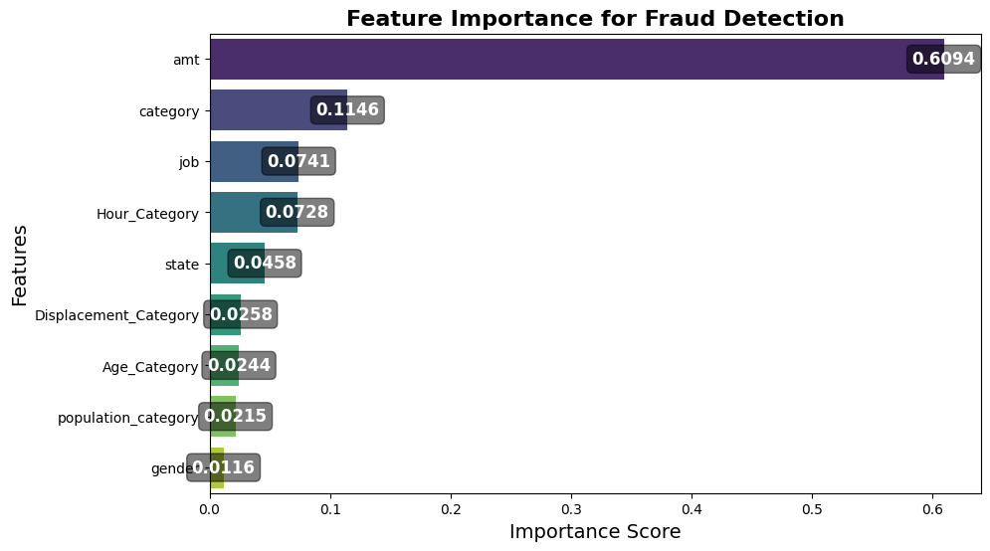
Feature Selection

Slide 14
DATASET DESCRIPTION
(100000, 10) where there are 100,000 transactions and 10 features.
Shape
(100000, 10) where there are 100,000 transactions and 10 features.
Features
amt: Transaction amount.
category: Type of purchase made.
Hour Category: Hour during which the transaction was made (morning, afternoon, evening, night).
state: State or region where the transaction occurred.
job: The occupation of the user.
gender: Gender of the user.
Age Category: User's age category.
population category: Population density of the user’s residential area.
Displacement Category: Distance or movement of the user during the transaction.
Is fraud: either transaction tagged as fraud (1)or not fraud(0)

Slide 15

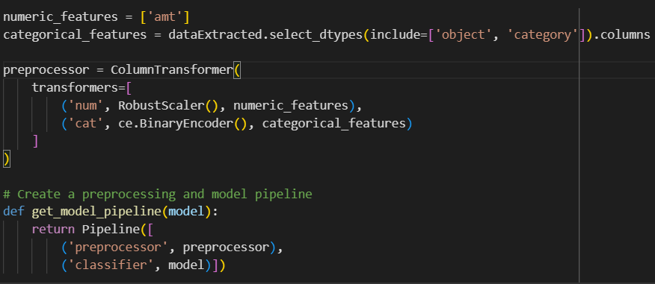
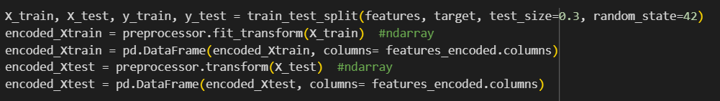
Machine Learning
Splitting the dataset:
Splitting the data between training and testing with a ratio of (70:30).
Creating a preprocessor and model pipeline to train a machine learning classifier model.

Slide 16
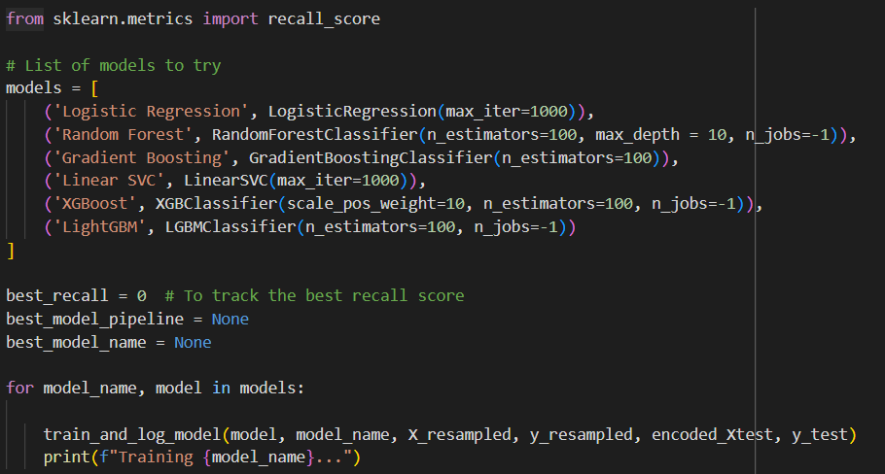
Machine Learning
Training different models:
Using a function to train different kinds of classification models in a for loop to understand the difference in performance metrics.
Comparing the recall score as it’s the most important metric for the project.

Slide 17
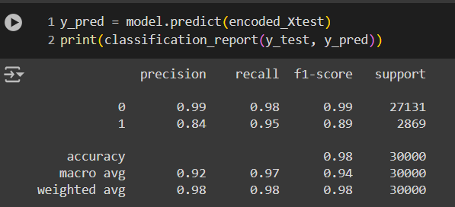
Machine Learning
Testing the best model:
The best model in training process was XGboost classifier.
Training results showed that the model has best fraud recall score of 95.6%.

Slide 18
Machine Learning
XGboost Overview:
Iterative model building: builds multiple models sequentially, where each new model is trained to correct the errors (residuals) of the previous one.
Ensemble approach: combines predictions from all models to improve overall accuracy.
Enhanced generalization: unlike traditional gradient boosting, XGBoost uses regularization, reducing overfitting and achieving a balance between bias and variance.
Performance advantage: known for its speed and effectiveness, making it popular for high-performance machine learning tasks.

Slide 19
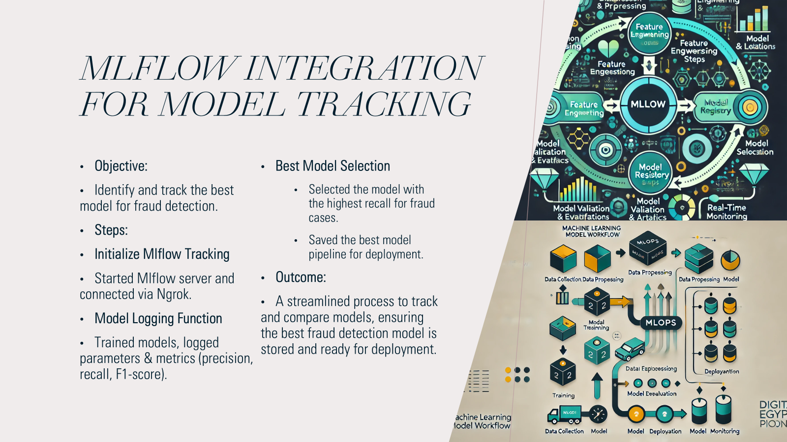

Slide 20
GANs
Challenges of vanilla GANs
Mixed data types: having mix of discrete and continuous columns, GANs must apply both softmax and tanh on the output.
Non-Gaussian distributions: Continuous values in tabular data are usually non-Gaussian.
Training with sparse one-hot-encoded vectors: The generative model is trained to generate a probability distribution over all categories using softmax, while the real data is represented to discriminator in one-hot vector.
Highly imbalanced categorical columns: leading to insufficient training opportunity for minor classes.

Slide 21
CTGAN
Conditional Tabular GANs specifically designed for generating synthetic tabular data.
introduces key innovations:
o Conditional Generation: By conditioning the generation process on specific categories, it can better handle categorical variables and their imbalances.
o Mode-Specific Normalization: the model learns multimodal distributions.

Slide 22
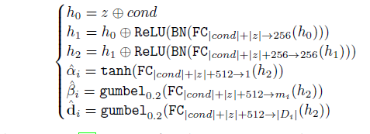
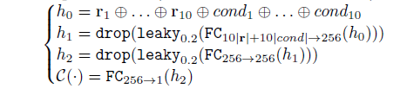
The generator
CTGAN
We used CTGAM model implemented in the Modeling Tabular data using Conditional GAN paper
The model utilized the mode-specific normalization, a conditional generator.
It used fully-connected networks, leaky ReLU activations, batch normalization and dropout.
the model used Wasserstein GAN loss and Adam optimizer.
.
The discriminator

Slide 23
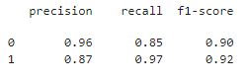
CTGAN
Results
Fraudulent synthetic data were augmented with original dataset and used for XGBoost classifier retraining.
Model performance improved for fraudulent class.
Non-fraud
Fraud

Slide 24

TECHNIQUES USED
Feature Engineering:
Scaling and normalization of numerical features (e.g., amt).
Binning of continuous variables into categories (e.g., Age Category, Hour Category).
Feature selection and importance
Handling Imbalance:
Oversampling: Synthetic techniques SMOTE (Synthetic Minority Oversampling Technique).
Data Cleaning and preprocessing
dataset is prepared for machine learning using Binary encoding for categorical variables and Robust scaling for numerical variables.

Slide 25
PROGRAMMING LANGUAGES + FRAMEWORKS
Python
Google colab
VS code
streamlit

Slide 26
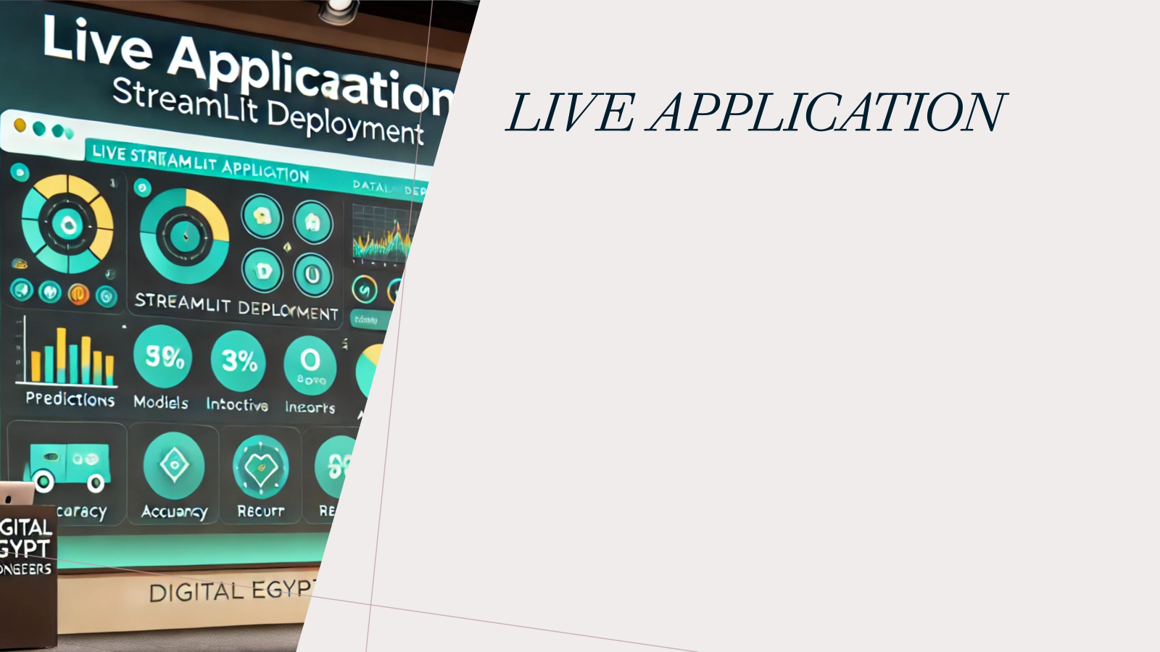
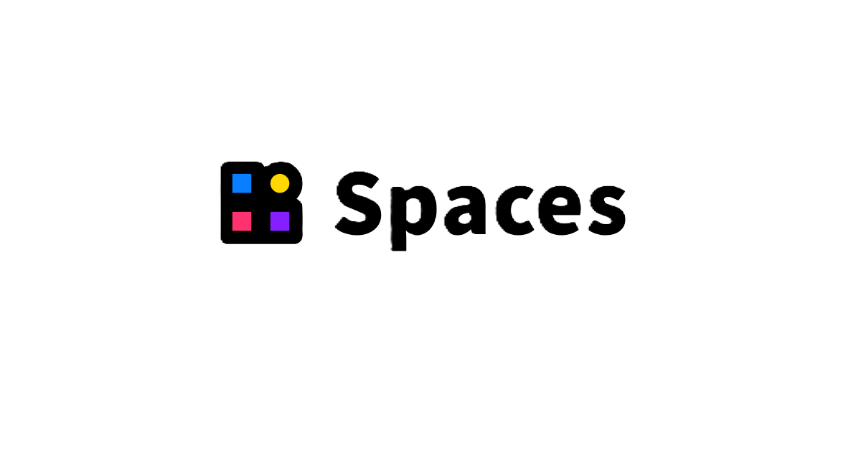

Platforms Used:
•Streamlit: Streamlit enables developers to create intuitive, interactive web applications that enhance user engagement with models.
•Hugging Face and Gradio: Hugging Face Spaces combined with Gradio simplifies model deployment, making it accessible for non-technical users.

Slide 27
Benefits to Individuals
•Personal Transaction Insights: Users gain detailed insights into their financial transactions, promoting informed decision-making and financial awareness.
•Improved Fraud Prediction Access: Enhanced accessibility fosters user confidence by empowering individuals to identify potential fraud risks proactively.

Slide 28
Benefits to Institutions
•Real-Time Fraud Detection: Instant alerts empower banks to respond promptly, significantly mitigating potential financial losses from fraud.
•Enhanced Customer Trust: Effective fraud detection fosters customer confidence, ensuring loyalty and positive institutional reputation over time.

Slide 29
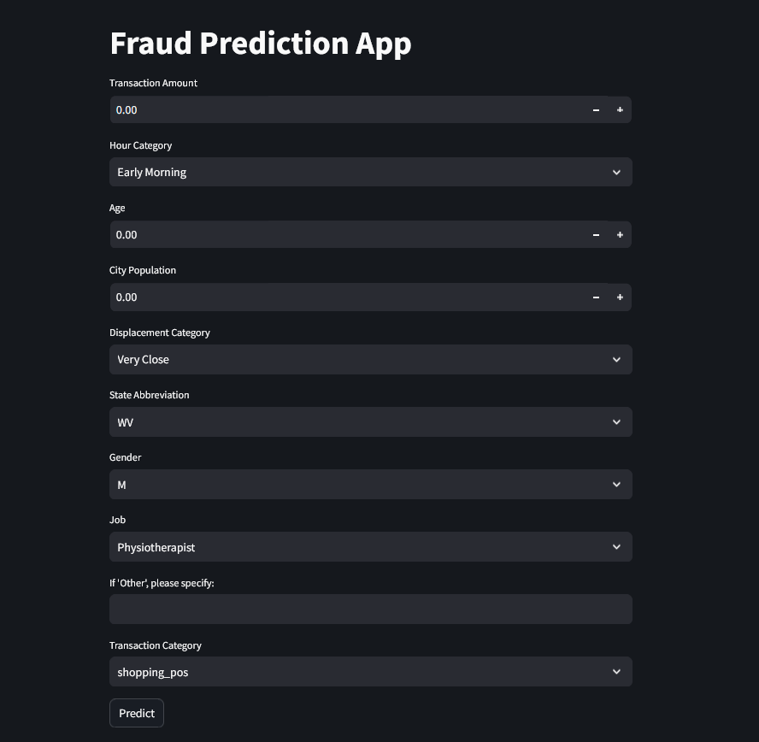
Streamlit App
User-Friendly Input: Allows users to effortlessly input transaction details, promoting immediate engagement and interaction with the system.
Instant Fraud Predictions: Users receive real-time fraud predictions, which enhances the decision-making process during potentially risky transactions.
Demo:

Slide 30
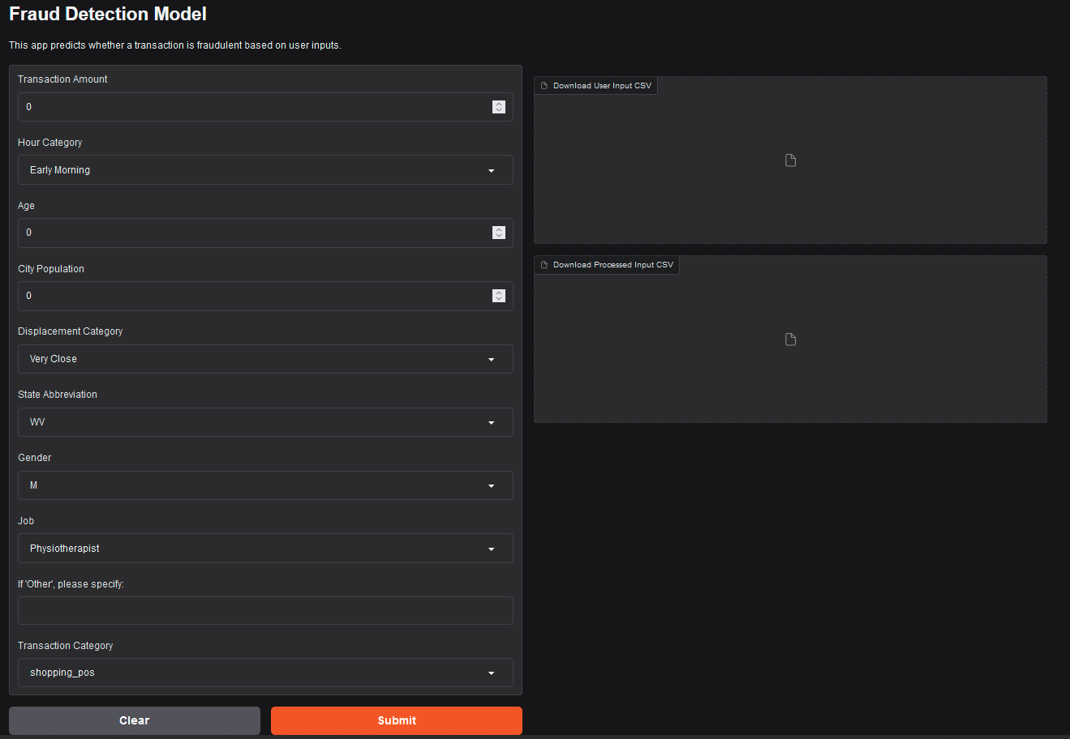
HF spaces App
•Gradio's User Interaction: Gradio offers an easy-to-navigate interface, enabling users to interact effortlessly with the fraud detection model.
Demo: https://huggingface.co/spaces/OmarAA/Depi_project_Fraud_Detection

Slide 31

DELIVERABLES
Project notebook:
link

Slide 32

PROJECT TEAM + ROLES
Mostafa Maged Data cleaning & processing
Hossam Machine learning models
Thorya Mahfoz Ahmed Mlflow Logging & Gans constructing
Aya GANs Training & synthetic Data
Omar Ashraf Deployment

